Slide 1

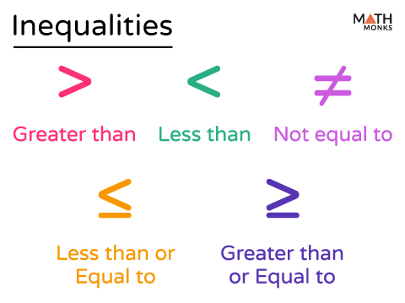
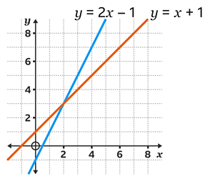
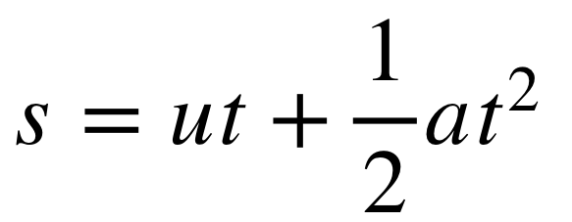
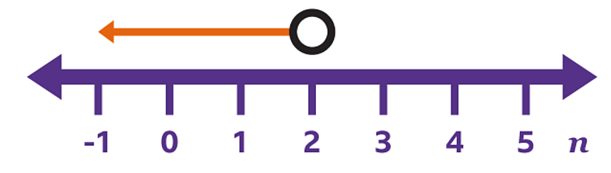
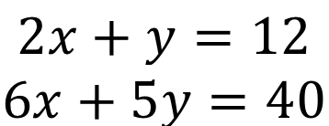
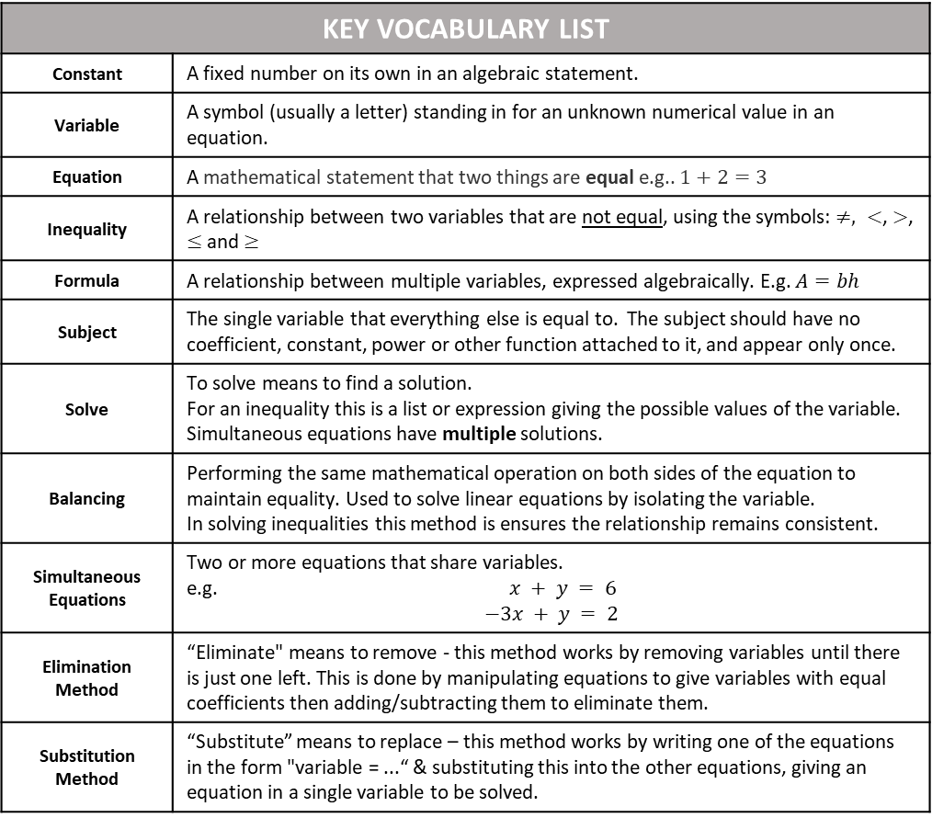
Name
Class
Tutor Group
YEAR 11 CORE MATHEMATICS
Unit 1: Further Algebra Linear Inequalities, Rearranging Formulae & Simultaneous Equations
KEY VOCABULARY LIST
Constant | A fixed number on its own in an algebraic statement.
Variable | A symbol (usually a letter) standing in for an unknown numerical value in an equation.
Equation | A mathematical statement that two things are equal e.g.. $1+2=3$
Inequality | A relationship between two variables that are not equal, using the symbols: $≠, <$, $>$, $≤$ and$≥$
Formula | A relationship between multiple variables, expressed algebraically. E.g. $A=bh$
Subject | The single variable that everything else is equal to. The subject should have no coefficient, constant, power or other function attached to it, and appear only once.
Solve | To solve means to find a solution. For an inequality this is a list or expression giving the possible values of the variable. Simultaneous equations have multiple solutions.
Balancing | Performing the same mathematical operation on both sides of the equation to maintain equality. Used to solve linear equations by isolating the variable. In solving inequalities this method is ensures the relationship remains consistent.
Simultaneous Equations | Two or more equations that share variables. e.g. $x + y = 6$ $$−3x + y = 2$$
Elimination Method | “Eliminate" means to remove - this method works by removing variables until there is just one left. This is done by manipulating equations to give variables with equal coefficients then adding/subtracting them to eliminate them.
Substitution Method | “Substitute” means to replace – this method works by writing one of the equations in the form "variable = ...“ & substituting this into the other equations, giving an equation in a single variable to be solved.

Slide 2
CONTENTS |  | PAGE
SUBTOPIC 1A | RECAP: Solving Equations | 3
 | GCSE QUESTIONS | 13
SUBTOPIC 1B | RECAP: Solving Equations – Unknowns on Both Sides | 15
 | GCSE QUESTIONS | 18
SUBTOPIC 2A | Linear Inequalities: Notation | 19
SUBTOPIC 2B | Linear Inequalities: On a Number Line | 22
 | GCSE QUESTIONS | 28
SUBTOPIC 2C | Linear Inequalities: Solving Single-Sided | 29
 | GCSE QUESTIONS | 45
SUBTOPIC 2D | Linear Inequalities: Solving Double-Sided (Challenge) | 47
SUBTOPIC 3 | Rearranging Formulae | 57
 | GCSE QUESTIONS | 70
SUBTOPIC 4A | RECAP: Plotting Linear Graphs | 72
 | GCSE QUESTIONS | 81
SUBTOPIC 4B | RECAP: Equation of a Straight Line | 83
 | GCSE QUESTIONS | 96
SUBTOPIC 8 | Simultaneous Equations: Graphical | 98
 | GCSE QUESTIONS | 107
SUBTOPIC 9 | Simultaneous Equations: Algebraic - By Elimination | 108
 | GCSE QUESTIONS | 130
SUBTOPIC 10 | Simultaneous Equations – Form & Solve | 131
 | GCSE QUESTIONS | 134
BOOKLET STRUCTURE
Start of subtopic:
Read and annotate the information in the Frayer model or introduction text
I do (teacher led example).
We do (teacher and scholar led example).
You do (independent scholar example).
Whiteboard check.
Independent practice and mixed practice.
End of subtopic:
Skills checks – key questions to help your teachers to pinpoint any issues.
GCSE questions – to ensure you are confident with the style you will encounter in your exams.

